Slide 1

Computational Study of the Reduction of Carbon Dioxide by Iron Modified TiO₂
By: Meghan Moloney
Mentor: Dr. Jean M. Andino
Space Grant Symposium
April 21, 2012

Slide 2
Problem
The Greenhouse Effect

Slide 3
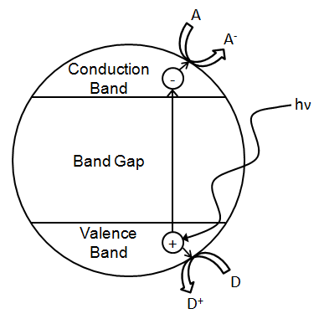
Background
TiO₂ as a photocatalyst
TiO₂ has a band gap of about 3.2 eV
Ultraviolet (UV) light (<400 nm), has enough energy to promote an electron across the band gap.¹
Iron modification-may shift band gap to visible light range
(1)Linsebigler, A. L.; Lu, G. Q.; Yates, J. T.: PHOTOCATALYSIS ON TIO2 SURFACES - PRINCIPLES, MECHANISMS, AND SELECTED RESULTS. Chemical Reviews 1995, 95, 735-758.

Slide 4
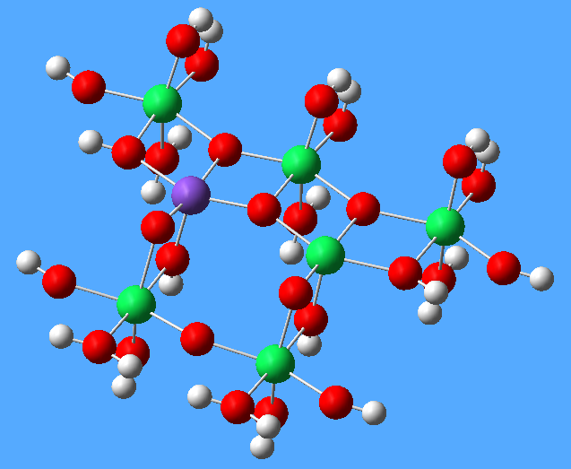
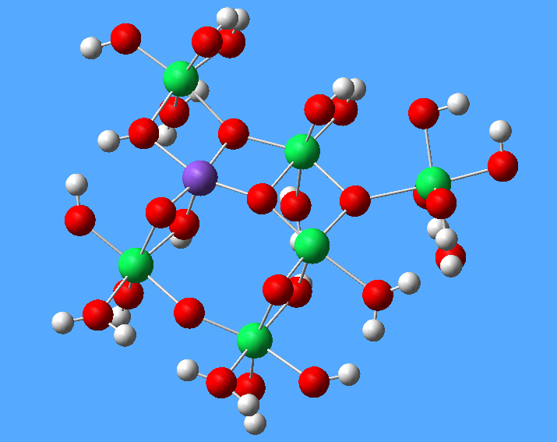
Methodology
Gaussian03 program package
Density Functional Theory (DFT)
Neutral/Negative modeling

Slide 5
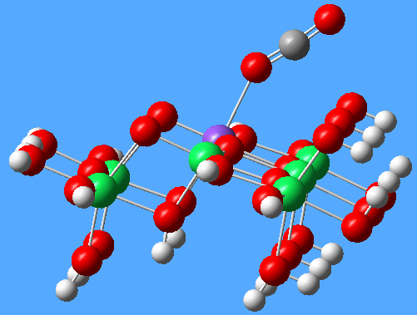
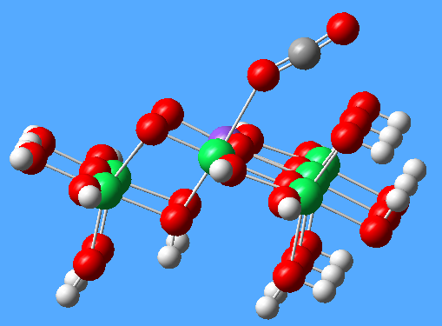
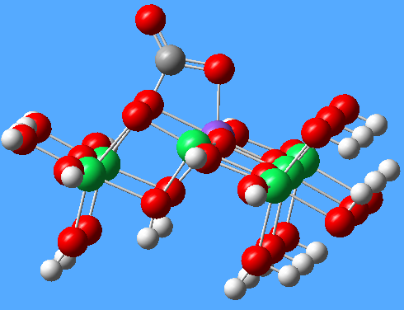
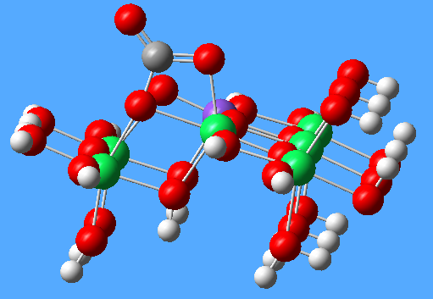
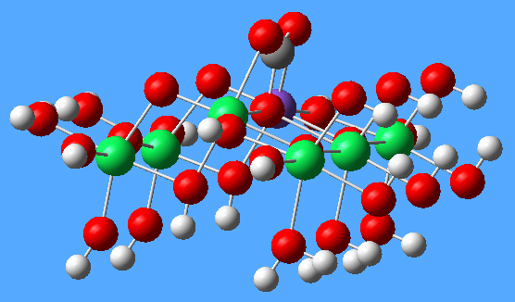
Results-Neutral Anatase (101)
A
B
C
D
E

Slide 6
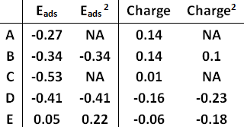
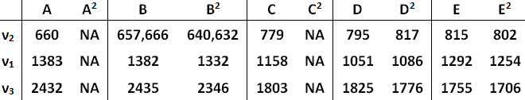
Results-Neutral Anatase (101)
Table 1. Adsorption energy (eV) of CO₂ on the cluster and charge on CO₂ for each bonding configuration.
Table 2. Vibrational frequencies (cm⁻¹) of bending (ν₂), symmetric stretching (ν₁) and asymmetric stretching (ν₃) for CO₂ on each bonding configuration.
(2) He, H.; Zapol, P.; Curtiss, L. A.: A Theoretical Study of CO(2) Anions on Anatase (101) Surface. Journal of Physical Chemistry C 2010, 114, 21474-21481.

Slide 7
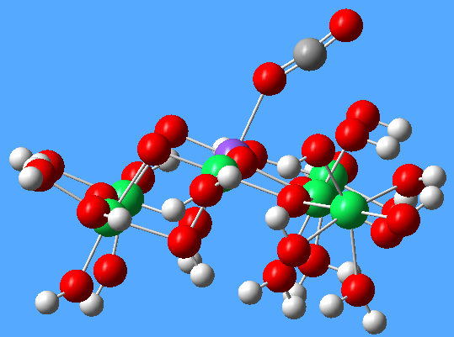
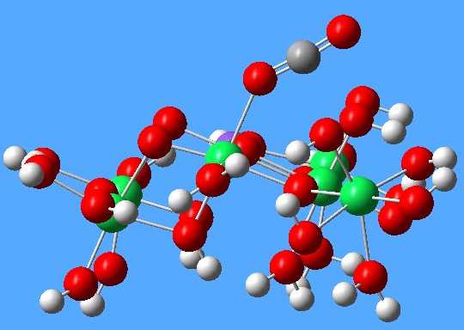
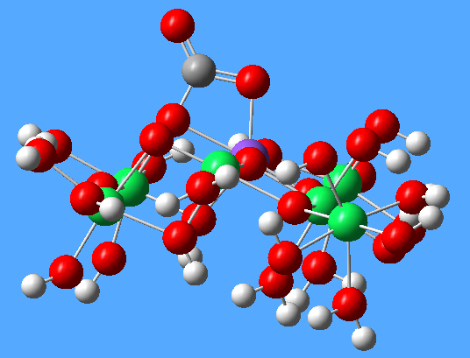
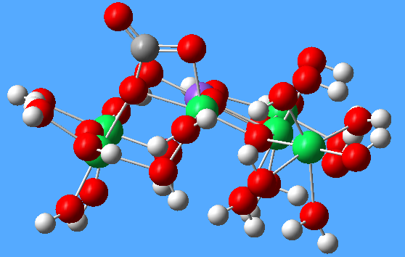
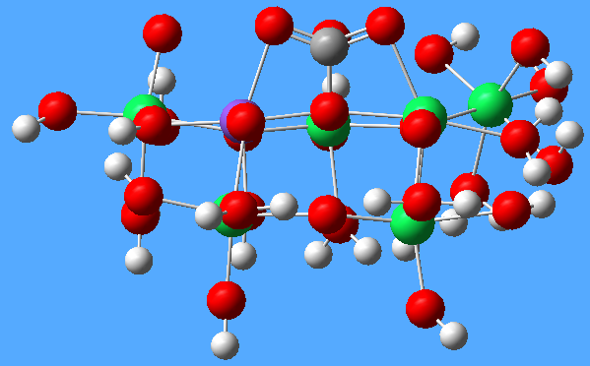
Results-Neutral Brookite (210)
A
B
C
D
E

Slide 8
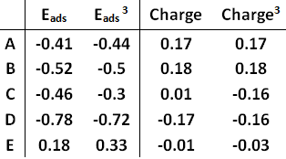
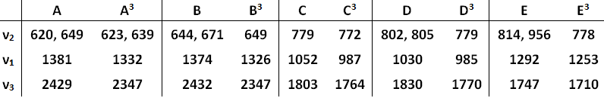
Results-Neutral Brookite (210)
Table 3. Adsorption energy (eV) of CO₂ on the cluster and charge on CO₂ for each bonding configuration.
Table 4. Vibrational frequencies (cm⁻¹) of bending (ν₂), symmetric stretching (ν₁) and asymmetric stretching (ν₃) for CO₂ on each bonding configuration.
(3) Rodriquez,M; Peng,X; Liu,L; Li,Y; Andino,J: A Density Functional Theory and Experimental Study of CO2 Interaction with Brookite TiO2. Submitted.

Slide 9
Conclusions
Neutral Anatase & Neutral Brookite
As expected, none of the configurations yield the anticipated first step to CO₂ reduction (the CO₂ anion).
Anatase with Fe modification yields 2 additional bonding configurations with CO₂ than without the modification.
Brookite with Fe modification yields more favorable CO₂ adsorption than without the modification.
Future Work
Negative anatase (101) & Negative brookite (210)
with Fe modification

Slide 10
Thank You!

